Slide 1






Introduction to Database
What is Database
Why are databases important
Types of database
Basic concepts
Notes:
Hello ! Welcome Aitrich Academy. In this session, we’ll be discussing about databases. It is introduced to overcome the deficiencies of traditional file based system. This session help you to understand more about data storage in databases. It include what is database, what are the importance of database, then there are many types of databases and finally the basic concepts associated with the system.
in this session we will explore the features, real world applications, history and an example of this powerful programming language.
So whether you're a complete beginner or have some programming experience and looking to dive into Java, this tutorial is perfect for you. Let's get started!

Slide 2



What is Database?
What is Database?
Usually controlled by a database management system (DBMS).
An organized collection of structured information, or data stored in a computer system.
Data + DBMS = A database system.
Can organize data into structures such as tables or collections.
Can operate a large amount of information by storing, retrieving, and managing data.
Notes:
In this session we discussing about what is database. It an organized collection of structured information, or data stored in a computer system. Simply in database data is stored and accessed electronically. It is a structured way of organizing information that can be easily queried, updated, and analyzed. A database management system or DBMS is used to create, manipulate, and maintain a database. A database system is the collective name for the data, the DBMS, and the applications associated with them. Databases are designed to organize and store data in a structured format that allows for efficient retrieval, querying, and manipulation of data. In relational databases, data is organized into tables . In non-relational databases, such as document-oriented databases or key-value stores, data is organized into collections or documents. The main purpose of the database is to operate a large amount of information by storing, retrieving, and managing data.

Slide 3
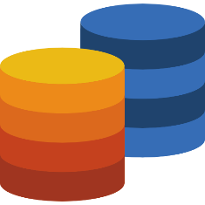
Why Databases important?
Distributed
Organization
Security
Object Oriented
Consistency
HANDLE INCRESING AMOUNT OF DATA ,
Scalability
SET OF RULES THAT ARE USED TO MAINTAIN THE INFORMATION QUALITY
Distributed
Integrity
Concurrency
UNIQUE CHARECTERISTICS ENABLES,TWO OR MORE USERS TO RETREIVE DATA FROM DATABASE AT SAME TIME WITHOUT EFFECTING DATA INTEGRIY
Notes:
Now we are going to understand the important features of databases. The following features make databases more better than traditional file based system.
First 1 is data organization . Databases provide a structure for organizing large amounts of data into particular structures to making it easier to find, access, and manage information. Then the second one is data consistency . By enforcing rules and constraints on the data, databases ensure that data remains consistent and accurate across all applications that use it.
Next is Data integrity. Databases provide mechanisms for ensuring that data is not lost or corrupted, and that it can be recovered in the event of hardware or software failures.
Fourth one is data security. Databases provide features for controlling who has access to the data, and what they can do with it, ensuring that sensitive information is kept confidential and protected from unauthorized access.
Fifth one is data scalability. Databases can handle large amounts of data, making it possible to store and manage huge datasets that would be impossible to handle using traditional file systems.
Then data concurrency. Databases provide mechanisms for managing multiple concurrent users, ensuring that users can access and modify the data without interfering with each other.

Slide 4

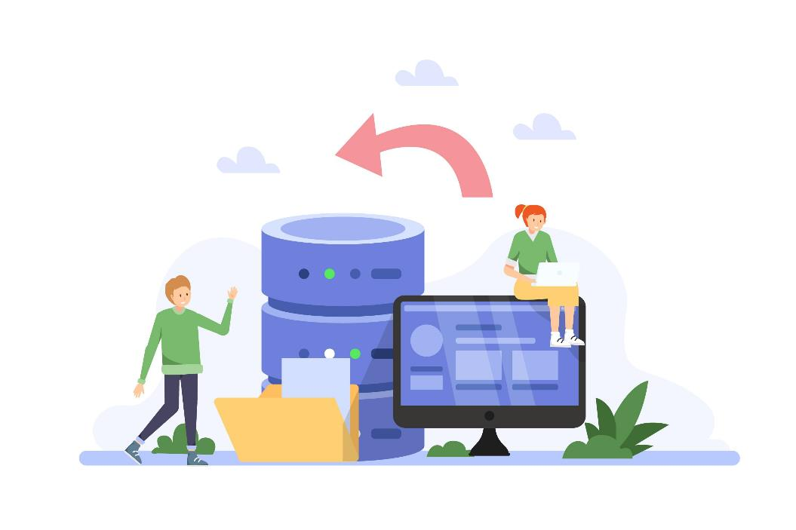
Type of databases
Relational database
Time series database
store data in tables that are related to each other using keys.
optimized for storing and querying time-series data, which is data that changes over time.
NoSQL database
Spatial database
store unstructured or semi-structured data.
designed to store and query spatial data, such as geographic information or satellite imagery.
Object oriented database
Cloud database
store data in the form of objects
that are hosted and managed in the cloud, and can be accessed from anywhere with an internet connection.
Graph database
store data in a graph structure, consisting of nodes and edges.
Notes:
Now we are move to the next session which explain the basic types of databases. There are several types of databases, each with its own specific characteristics and use cases. Some of the most common types of databases are.
First one Relational databases: These are the most widely used type of database, and they store data in tables that are related to each other using keys. MySQL, Oracle, and Microsoft SQL Server are some examples of relational database. Next one is NoSQL databases: These databases do not use the traditional tabular structure and are used to store unstructured or semi-structured data. MongoDB, Cassandra, and Amazon DynamoDB are some examples. Then Object-oriented databases: These databases store data in the form of objects, rather than tables, making them more suitable for object-oriented programming. Examples of object-oriented databases are Versant Object Database and ObjectStore. Then fourth one is Graph databases : These databases store data in a graph structure, consisting of nodes and edges. They are ideal for managing data with complex relationships, such as social networks or recommendation engines. Then Time-series databases: These databases are optimized for storing and querying time-series data, which is data that changes over time. Spatial databases: These databases are designed to store and query spatial data, such as geographic information or satellite imagery. PostGIS and Oracle Spatial are some examples. Finally Cloud databases: These are databases that are hosted and managed in the cloud, and can be accessed from anywhere with an internet connection. Examples of cloud databases include Amazon RDS, Google Cloud SQL, and Microsoft Azure SQL Database.

Slide 5








Basic concept of databases
Database schema
THEY DEFINE LIMITATIONS THAT DATA MUST MEET
Data constraints
Data Engine
Data manipulation
Data dictionary or Metadata
Query
Database instance
Notes:
Next we will discussing about basic concept of databases.
Here we are going to learn the 7 basic concepts.
Lets look them one by one.
First 1. Database Schema: It is a design of the database. Or we can say that it is a skeleton of the database that is used to represent the structure, types of data will be stored in the rows and columns, constraints, relationships between the tables.
Data Constraints: In a database, sometimes we put some restrictions on the table that what type of data can be stored in one or more columns of the table, it can be done by using constraints. Constraints are defined while we are creating a table.
Data dictionary or Metadata: Metadata is known as the data about the data. Or we can say that the database schema along with different types of constraints on the data is stored by DBMS in the dictionary is known as metadata.
Database instance: In a database, a database instance is used to define the complete database environment and its components. Or we can say that it is a set of memory structures and background processes that are used to access the database files.
Query: In a database, a query is used to access data from the database. So users have to write queries to retrieve or manipulate data from the database.
Data manipulation: In a database, we can easily manipulate data using the three main operations that is Insertion, Deletion, and updating.
Data Engine: It is an underlying component that is used to create and manage various database queries.
3

Slide 6

Thank you

